Slide 1
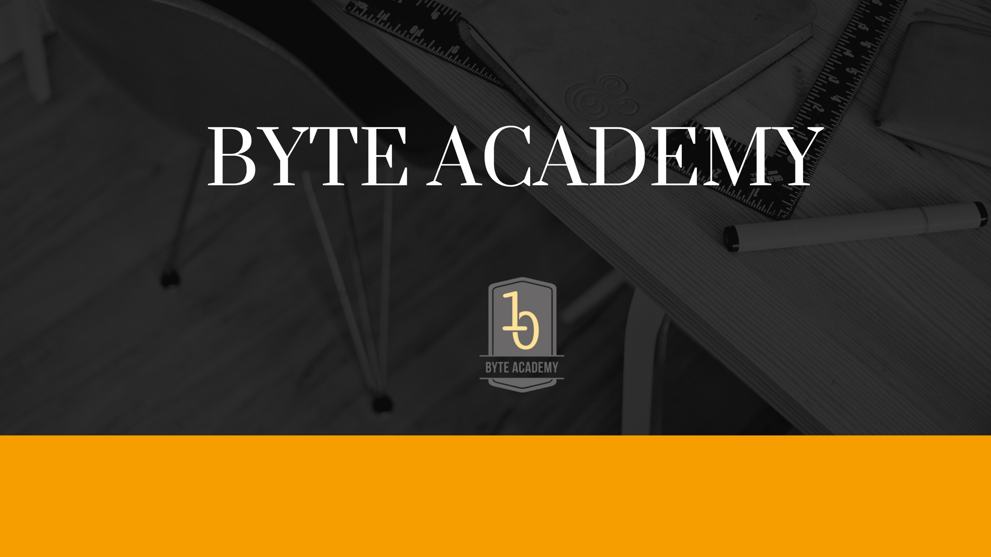

Slide 2

Introduction to Python

Slide 3

Some Useful Modules
Collections
Time
Datetime
Pickle
Sys
os

Slide 4
Collections
This module implements some nice data structures which will help you to solve various real life problems.
From Collections import Counter: Counter is a dict subclass which helps to count hashable objects. Inside it elements are stored as dictionary keys and counts are stored as values which can be zero or negative.
Check out more useful methods at https://docs.python.org/2/library/collections.html

Slide 5
Time and Datetime
Many times, we need to include dates or the current time in our programs.

Slide 6
Sys
Sys allows us to pythonically interact with our shells.

Slide 7
Os
The functions that the OS module provides allows you to interface with the underlying operating system that Python is running on – be that Windows, Mac or Linux.
You can find important information about your location or about the process.

Slide 8
Pickle
It is used for serializing and de-serializing a Python object structure. Any object in python can be pickled so that it can be saved on disk.
Its most common use is for saving a program's state data to disk so that it can carry on where it left off when restarted (persistence)

Slide 9


